Slide 1

Project Presentation
ON
DriveHub
(Course Code: CS253)
Presented By:
Navdeep Singh Chaudhary (2211981238)
Prabhav Sharma (2211981269)
Nikhil (2211981242)
Parshotam Singh (2211981263)
1

Slide 2
Introduction
DriveHub is a comprehensive digital automobile marketplace platform designed to simplify the buying and selling of cars through a secure, transparent, and user-friendly online environment.
Problem Statement:
Traditional car buying and selling is time-consuming
Lack of trust between buyers and sellers
Limited access to verified vehicle details
Dependency on third-party communication
Unsafe payment transactions and poor documentation
Solution:
DriveHub provides car listing, direct buyer-seller chat, secure payments, vehicle image verification, and automatic PDF bill generation in one platform.

Slide 3
Technology Stack
Frontend:
React.js (User Interface)
Backend:
Node.js
Express.js
Database:
MongoDB
Authentication:
Clerk
Payment Integration:
Secure Payment Gateway
UI Design:
Tailwind CSS
Development Tool:
Visual Studio Code

Slide 4
Project Abstract
DriveHub is a digital car marketplace platform where users can buy and sell cars efficiently in one place.
Main Functions:
Upload and list cars for sale
Browse available vehicles without registration
View full vehicle details with high-quality images
Chat directly with car owners
Make secure online payments
Generate automatic PDF bills after purchase
This makes car transactions faster, safer, and more organized while improving trust and transparency.

Slide 5
Objectives
Objectives of DriveHub
To develop a secure digital automobile marketplace platform
To simplify online buying and selling of cars
To provide open-access browsing without mandatory login
To improve buyer confidence using full vehicle images
To enable direct real-time communication between buyers and sellers
To ensure secure online payment transactions
To generate automated PDF bills for proper documentation
To create a scalable and user-friendly platform

Slide 6
Key Features
Key Features
User Authentication using Clerk
Car Upload & Management
Vehicle Listing with Full Details
Open Browsing Without Registration
High-Quality Vehicle Images
Real-Time Chat Between Buyer and Seller
Secure Payment Gateway
Automatic PDF Bill Generation
Transaction History Management
Responsive UI for Mobile and Desktop

Slide 7
High-Level Design

Slide 8
System Architecture
3-Tier Architecture
Frontend (React.js + Tailwind CSS)
Handles UI and user interactions
Car browsing, listing, chat, and payments
Backend (Node.js + Express.js)
Processes requests and application logic
JWT authentication and transaction handling
Database (MongoDB)
Stores users, cars, chats, payments, and bills
Payment Layer
Secure payment verification and processing
Data Flow:
User → Frontend → Backend → Database/Payment → Frontend

Slide 9
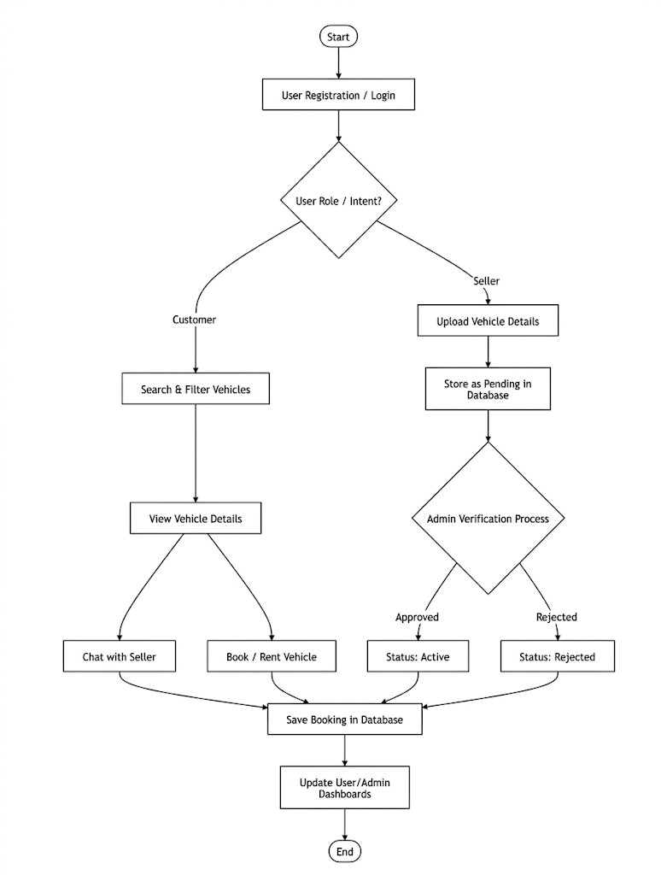
Flowchart Diagram
This flowchart represents the working process of my buying and Selling System from start to end.
It begins with user registration/login, where the user chooses their role as customer or seller.
Customers can search vehicles, view details, chat with sellers, and buy or sell vehicles, while sellers upload vehicle details for admin verification.
After approval, booking details are saved in the database, and user/admin dashboards are updated successfully.

Slide 10
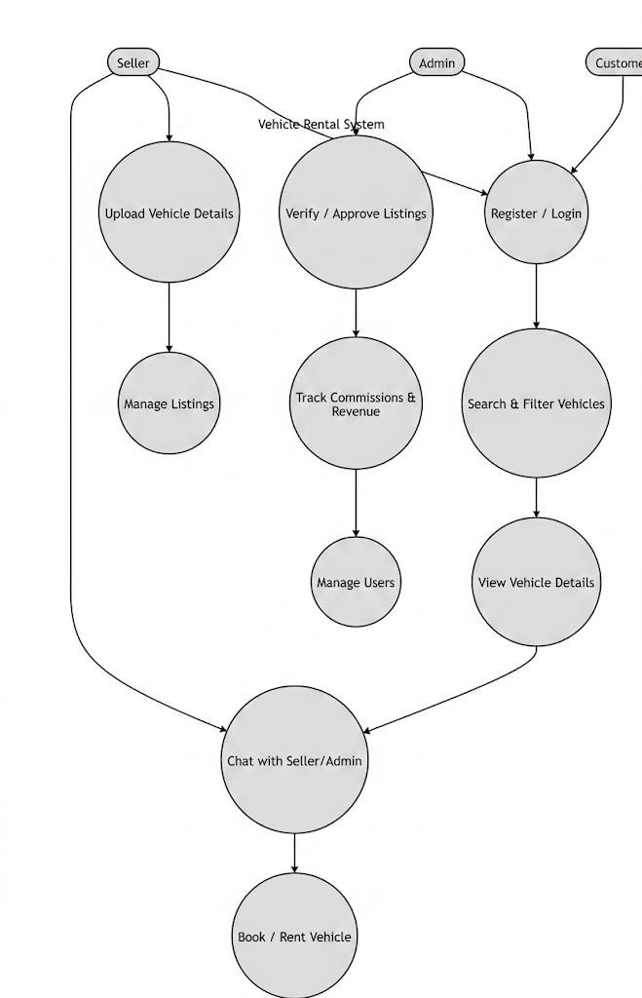
Use Case Diagram
This UML Class Diagram represents the structure of my Vehicle Rental and Selling System project.
It includes four main classes: User, Listing, Message, and Booking.
The User class manages registration and login, and users can act as customers or sellers.
Sellers create vehicle listings, while customers can view and book available vehicles.
The Message and Booking classes handle communication and booking details, making the system organized and efficient.

Slide 11
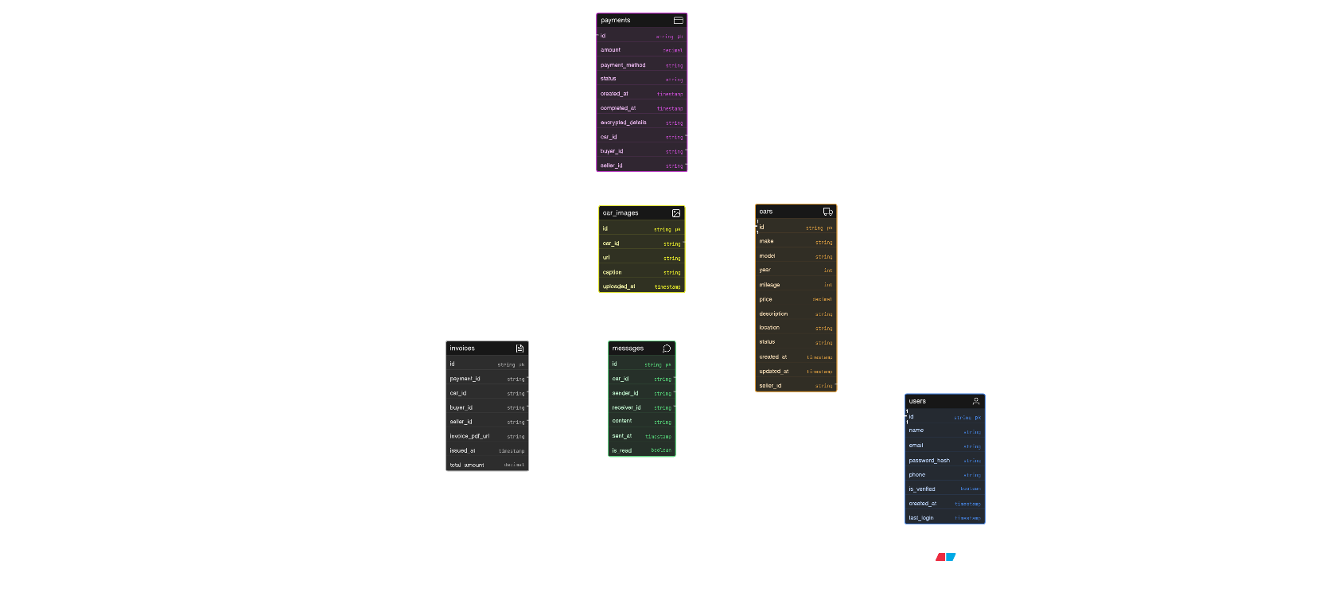
ER Diagram

Slide 12
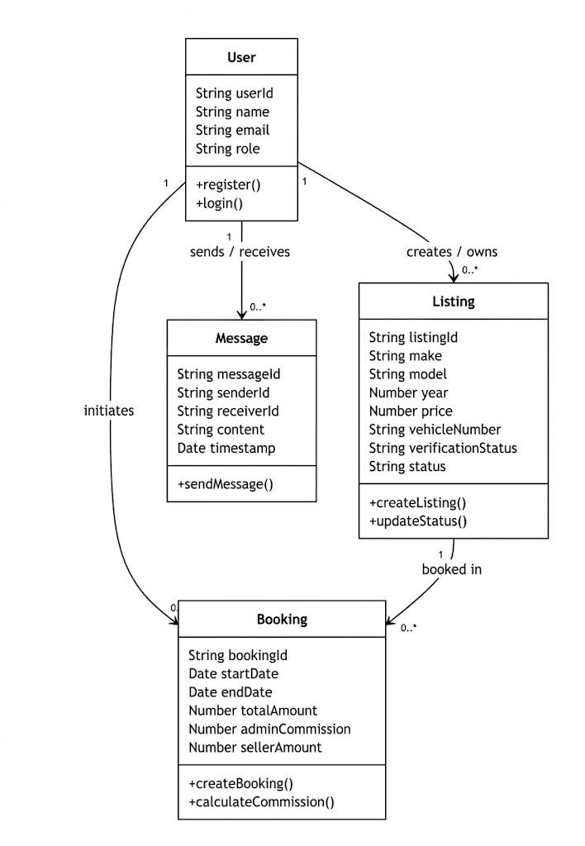
Class Diagram

Slide 13
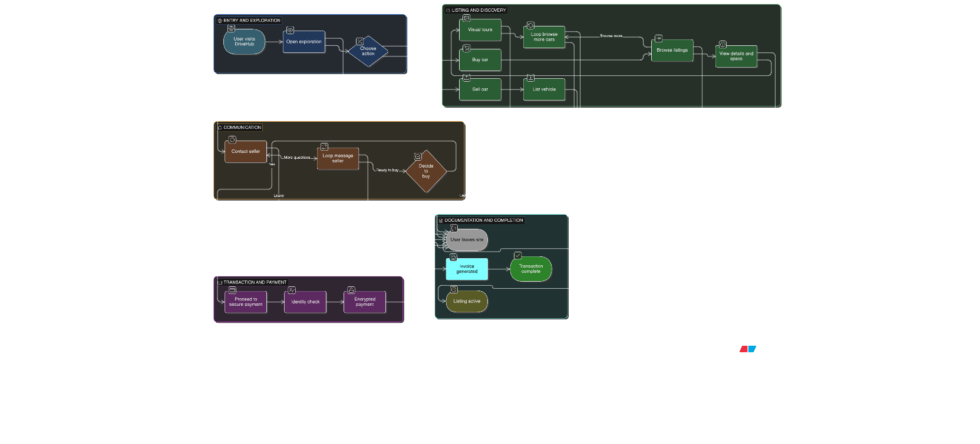
Flow Chart

Slide 14
Testing & Results
Testing
Unit Testing for authentication, listings, payment, and chat modules
Integration Testing for frontend-backend communication
Functional Testing for all major features
UI Testing for responsiveness and navigation
Performance Testing with large image uploads and multiple listings
Results
Car upload and listing worked successfully
Buyers could browse vehicles smoothly
Chat system worked properly in real time
Payment gateway completed secure transactions
PDF bill generation worked accurately
Overall platform provided a smooth user experience

Slide 15
Limitations
Limitations
Internet connection is required for all major features
Payment gateway depends on third-party services
Large image uploads may affect performance
Verification of seller information is limited
Platform currently supports only car transactions
Limited offline functionality
Basic personalization features only

Slide 16
Future Scope
Future Scope
Add support for bikes and commercial vehicles
Implement AI-based vehicle price prediction
Add vehicle verification using AI image analysis
Develop mobile application for better accessibility
Add live location tracking for delivery
Introduce loan and EMI calculator features
Enable service history tracking for vehicles
Improve dashboard analytics and user recommendations

Slide 17
Conclusion
DriveHub provides a modern, secure, and efficient solution for online automobile transactions.
It improves:
Accessibility
Buyer-Seller Trust
Secure Transactions
Documentation Transparency
Overall User Experience
DriveHub creates a reliable and scalable digital ecosystem for the future of automobile commerce.

